Slide 1

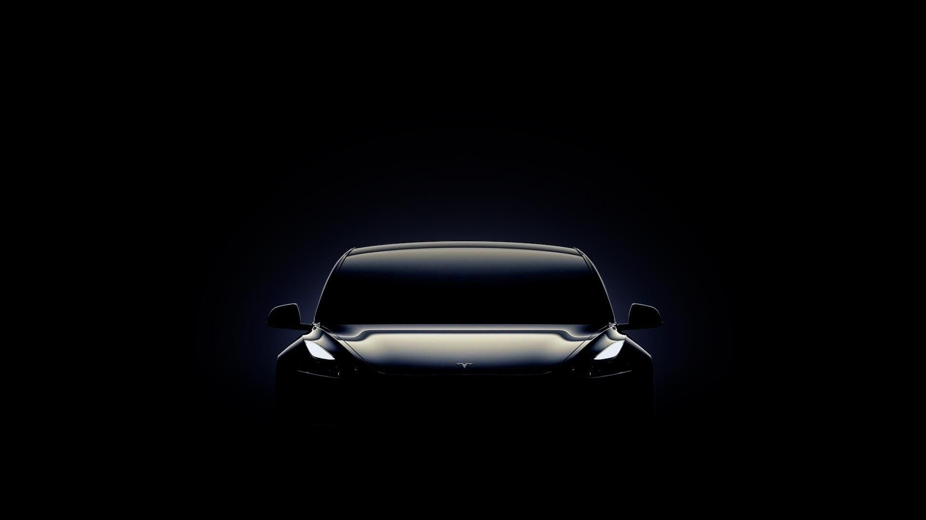

Matis Chabanat
TD1 – TP1
01/12/2023
Bachelor’s Degree in Computer Science
Semester 3 | R3.12 - English

Slide 2


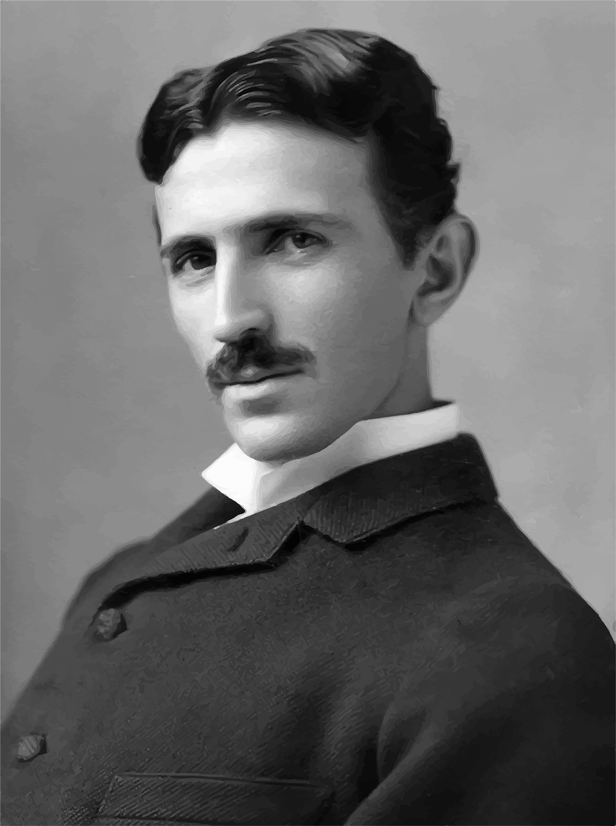
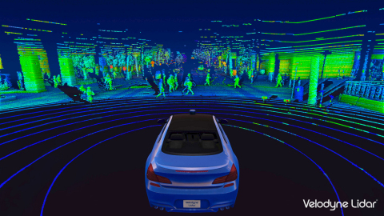
Tesla’s story
2
Tesla Motors (2003-2017)
Tesla Inc (2017-...)
Create cars using new technologies
Nikola Tesla

Slide 3
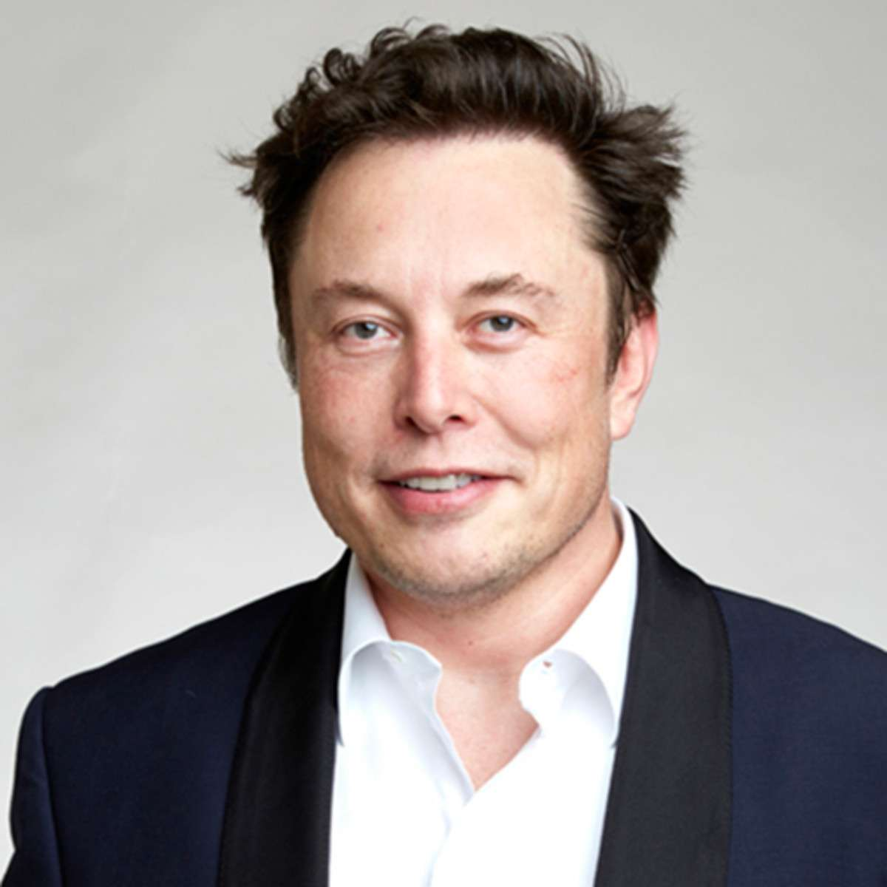
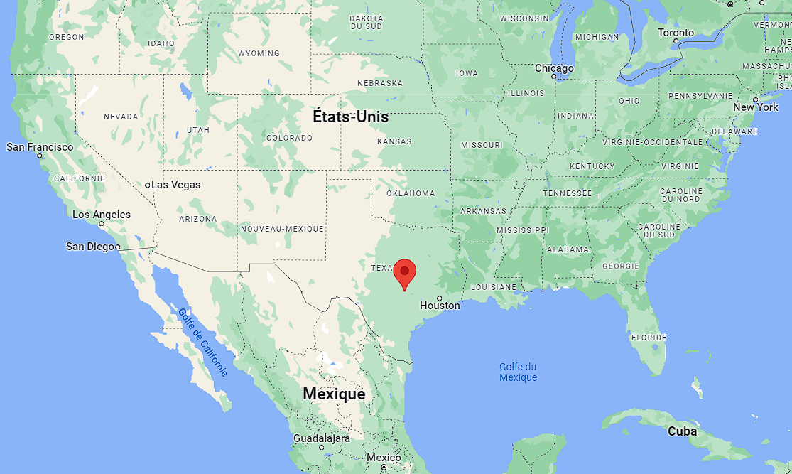
Importants facts (1/2)
3
CEO: Elon Musk
Location: Austin, Texas, USA

Slide 4
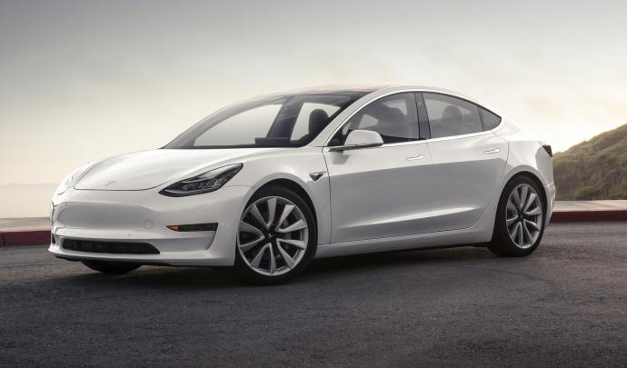
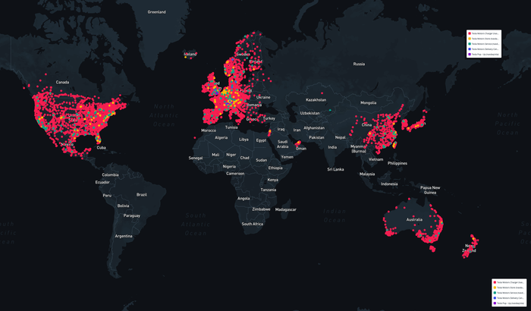
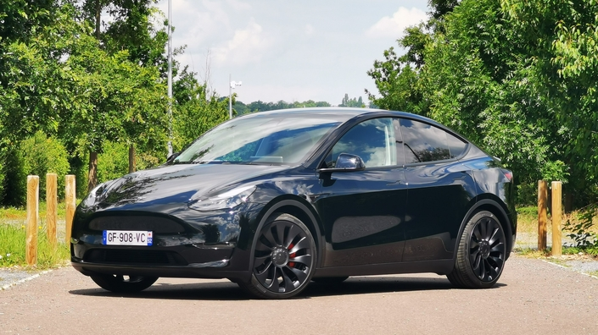
Importants facts (2/2)
4
Important facts:
85% market share in the high-end electric vehicle sector
International influence
Flag ship product: Electric cars

Slide 5
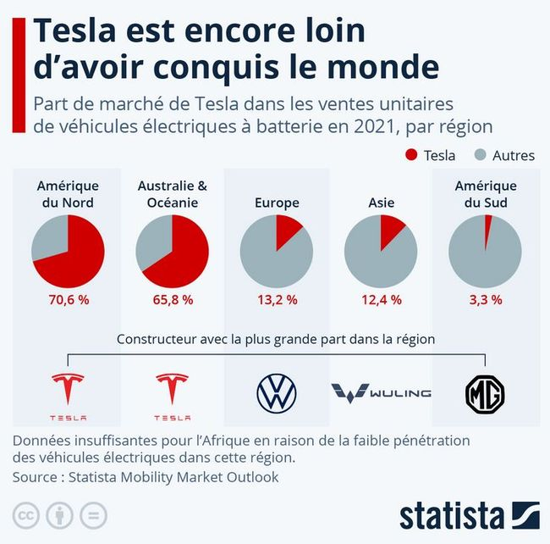
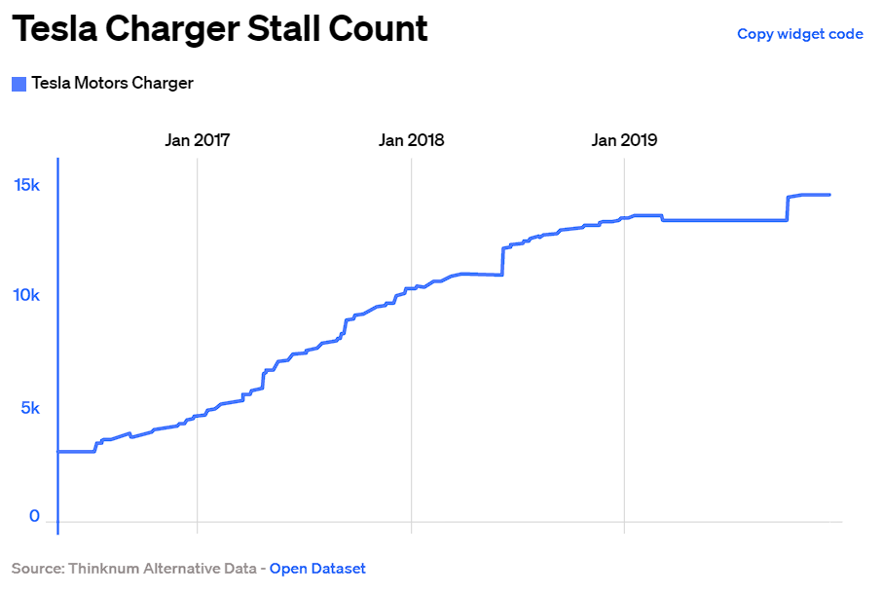
Important figures
5

Slide 6
Conclusion
6

Slide 7
Thanks for listening!

Slide 8
Sources
https://vividmaps.com/the-countries-that-pay-the-most-and-least-for-a-tesla-mapped/
https://www.businessofbusiness.com/articles/the-tesla-empire-on-a-world-map/
https://www.auto-infos.fr/article/ou-en-est-tesla-a-l-echelle-mondiale.257357

